Slide 1

Biological orientation responses in animals
1 – Taxes and Kineses

Slide 2
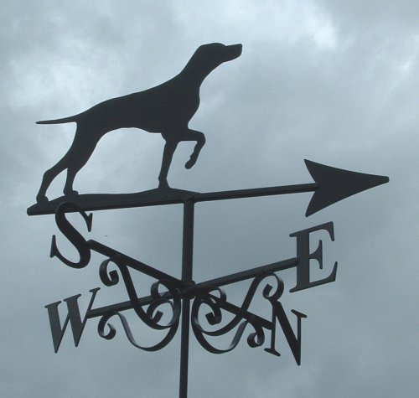
Orientation
= behaviour that positions an animal in a certain direction

Slide 3
Useful Prefixes for Abiotic factors
Photo- Light (intensity, direction, duration)
Geo- Gravity (up and down)
Thermo- Temperature (range, average)
Hydro- Water (humidity, soil moisture)
Rheo- Current (running water direction)
Chemo- Chemicals (salt, pH, toxins, ions)
Thigmo- Touch

Slide 4
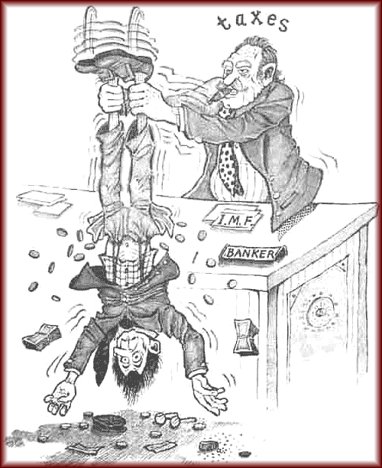
Taxes (singular – taxis)
The movement of the whole animal either toward (positive), away from (negative) or at a fixed angle in relation to a stimulus.
Prefixes such as photo, geo etc. are used
Not this sort of taxes

Slide 5
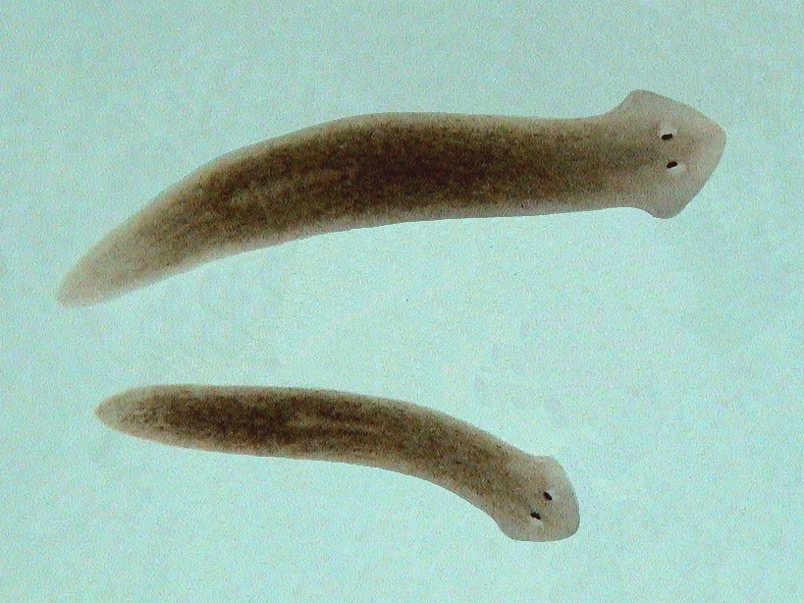
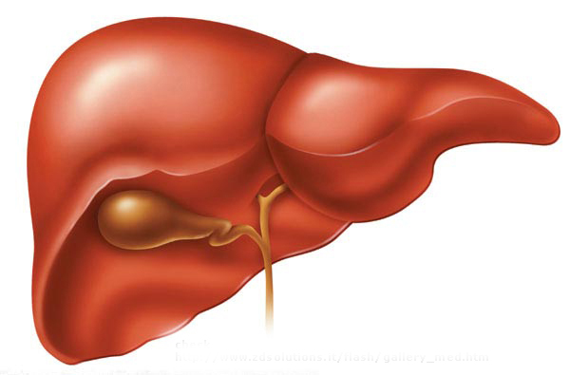
Freshwater flatworms show positive chemotaxis when they move toward a piece of liver.
WARNING – parts of this animation may not be exactly realistic, but No flatworms were harmed during its production

Slide 6

Moths show positive phototaxis in that they will fly toward a light.

Slide 7



If an animal uses two receptors that each judge the distance of a stimulus to pinpoint the source of the stimulus it is called a tropotaxis.
Male moths show positive chemo-tropotaxis when they zero in on a female moth producing a pheromone.
Female
Pheromones
Male

Slide 8
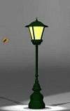
Telotaxis is where an animal (e.g.moth) can use one sense organ to orient itself in relation to a stimulus.
E.g a moth can fly at a fixed angle to a light even with one eye covered (e.g.photo-telotaxis)

Slide 9
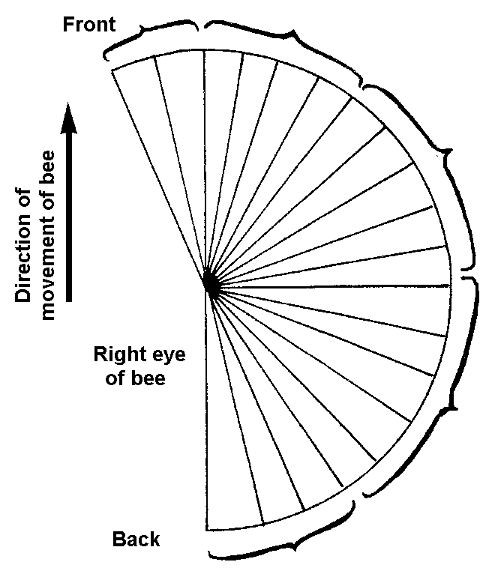
Stimulation of these ommatidia causes turning to the left
Photo-telotaxis
How a honey bee can walk up a beam of light with one eye covered
Stimulation of these causes no turning
Stimulation of these causes turning right
Stimulation of these causes rapid turning right
Stimulation of these causes violent turning right

Slide 10
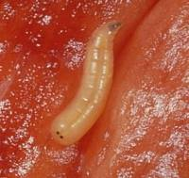
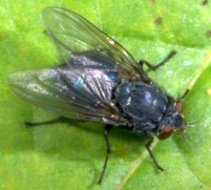
Klinotaxis
When a blowfly maggot is ready to pupate it moves away from light to find a dark spot to hide. (see next slide)
mum
maggot

Slide 11
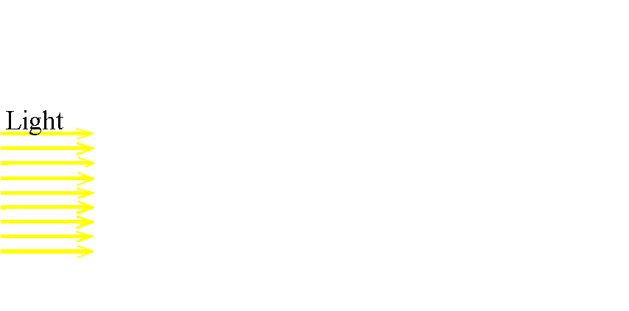
Klinotaxis is where an animal uses its one receptor to test the environment in order to orient itself.
A maggot shows negative photo-klinotaxis when it keeps turning its head from side to side to move away from directional light.

Slide 12
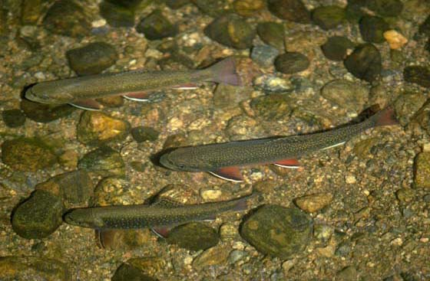
Rheotaxis
Trout will line themselves in an upstream direction.

Slide 13
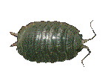
Kineses
A non-directional response to a stimulus
A change in activity resulting from the change in intensity of the stimulus
Orthokinesis = change in speed
Klinokinesis = change in rate of turning

Slide 14
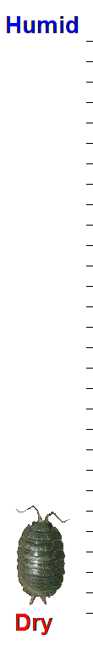
Orthokinesis in Slaters
Slows in comfortable conditions

Slide 15
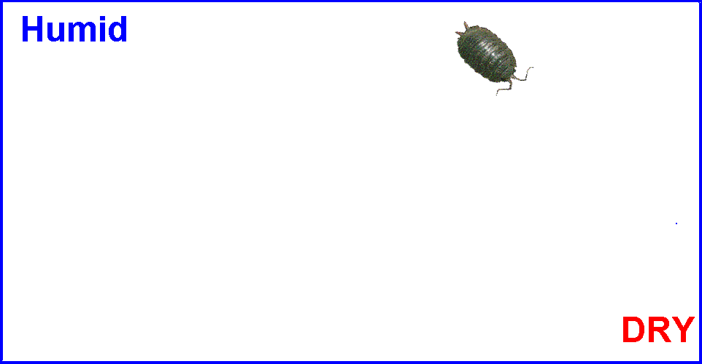
Klinokinesis
Turns more in comfortable conditions
Te Mutu

